Slide 1
Software Engineering
Juhyeon Kim Suji Oh
Dongju Yu Sohee Lee
Jak-sim-sam-il
STUDY APP

Slide 2
Unit 01 ㅣ Introduction of our application project
Contents
Unit 02 ㅣ Development environment
Unit 03 ㅣ Structures of Application
Unit 04 ㅣ Q&A

Slide 3
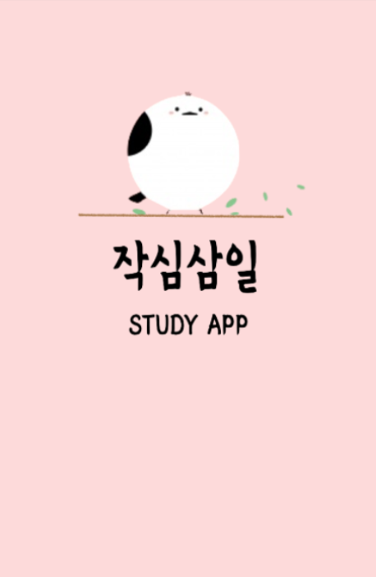
Software Engineering
Study app ‘Jaksimsamil’
Unit 01 ㅣ Introduction of our application project
작심삼일 (作心三日) Jak sim sam il
: a short-lived resolve, an unsteady plan
Resolutions never last more than three days.

Slide 4
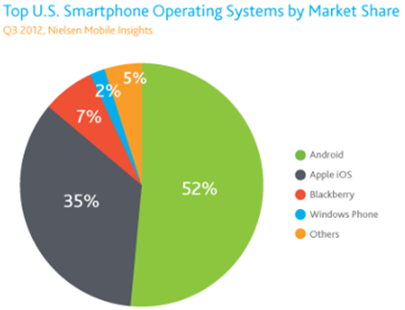
Software Engineering
Study app ‘Jaksimsamil’
Software Engineering
Study app ‘Jaksimsamil’
Unit 02 ㅣ Development environment
Unit 02 ㅣ Development environment
Choice of software development platform
: Android OS
Mobile Operating System of Google
Used in many fields
Many tools about guidance

Slide 5



문화콘텐츠 마케팅
기말평가 영화재마케팅하기
Software Engineering
Study app ‘Jaksimsamil’
Unit 01 ㅣ 마케팅 환경분석 _ Market Environment Analysis
Unit 02 ㅣ Development environment
Tool and Language in Use
JAVA
XML
Android Studio

Slide 6
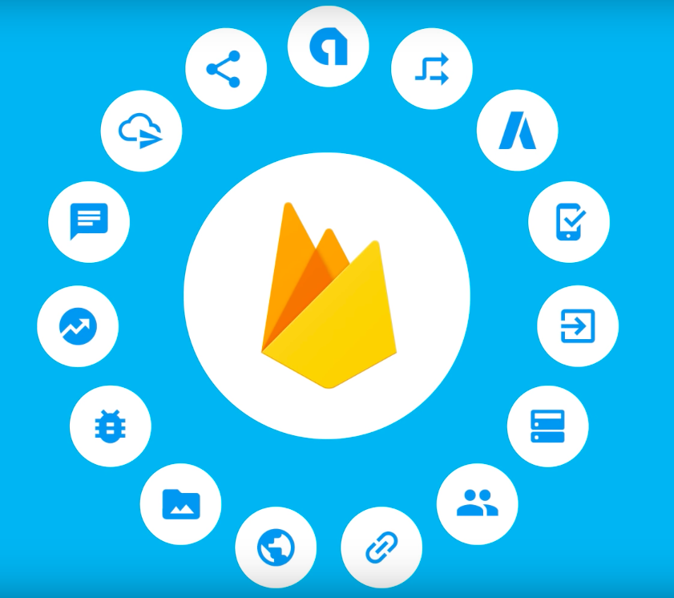
문화콘텐츠 마케팅
기말평가 영화재마케팅하기
Software Engineering
Study app ‘Jaksimsamil’
Unit 01 ㅣ 마케팅 환경분석 _ Market Environment Analysis
Unit 02 ㅣ Development environment
Software in Use: Firebase
To build for platform: need back-end server
- to store data
- to support the apps

Slide 7

문화콘텐츠 마케팅
기말평가 영화재마케팅하기
Software Engineering
Study app ‘Jaksimsamil’
Unit 01 ㅣ 마케팅 환경분석 _ Market Environment Analysis
Unit 02 ㅣ Development environment
Software in Use: SQLite
Relatively light Database
used in application
Built in Google android OS.
Available by inheriting SQLiteOpenHelper
in the DBHelper class

Slide 8
Software Engineering
Study app ‘Jaksimsamil’
Software Engineering
Study app ‘Jaksimsamil’
Unit 03 ㅣ Structures of Application
Unit 03 ㅣ Structures of Applications
Function: Splash
Splash screens are the advertising time that exposes a company's brand to users and the time to load data to run an application.

Slide 9
문화콘텐츠 마케팅
기말평가 영화재마케팅하기
Software Engineering
Study app ‘Jaksimsamil’
Unit 01 ㅣ 마케팅 환경분석 _ Market Environment Analysis
Unit 03 ㅣ Structures of Application
Function: Log-In
Inserted the Google api “FirebaseUI”,
- can log in to Google, Facebook, and Naver
accounts easily.

Slide 10

문화콘텐츠 마케팅
기말평가 영화재마케팅하기
Software Engineering
Study app ‘Jaksimsamil’
Unit 01 ㅣ 마케팅 환경분석 _ Market Environment Analysis
Unit 03 ㅣ Structures of Application
Firebase UI
a library built on the Firebase Certification SDK
Provides an in-place UI flow that can be used by the app.
Advantage - Multiple providers
- Account management
- Account connection
- Custom themes
- Password replacement Smart Lock

Slide 11
문화콘텐츠 마케팅
기말평가 영화재마케팅하기
Software Engineering
Study app ‘Jaksimsamil’
Unit 01 ㅣ 마케팅 환경분석 _ Market Environment Analysis
Unit 03 ㅣ Structures of Application
Function: Navigation Bar
Navigation drawer = DrawerLayout, NavigaitionView,
ActionBarDrawerToggle
Includes a variety of options
Designed to easily move to other features of the application
Profile, Chat with friends, Add new task, Calendar, Alarm, Share, Send

Slide 12
문화콘텐츠 마케팅
기말평가 영화재마케팅하기
Software Engineering
Study app ‘Jaksimsamil’
Unit 01 ㅣ 마케팅 환경분석 _ Market Environment Analysis
Unit 03 ㅣ Structures of Application
Function: Profile
Picasso: an image library for Android.
Created & maintained by Square and carters
Simplifies the progress of displaying images
Library handles every stage of the process

Slide 13
문화콘텐츠 마케팅
기말평가 영화재마케팅하기
Software Engineering
Study app ‘Jaksimsamil’
Unit 01 ㅣ 마케팅 환경분석 _ Market Environment Analysis
Unit 03 ㅣ Structures of Application
Function: Friends (chat)
Adapter
- the data must be stored in what is
called an adapter,
- Creates the view
- Acts as a total management institution

Slide 14
문화콘텐츠 마케팅
기말평가 영화재마케팅하기
Software Engineering
Study app ‘Jaksimsamil’
Unit 01 ㅣ 마케팅 환경분석 _ Market Environment Analysis
Unit 03 ㅣ Structures of Application
Function: To Do List
ADD/DELETE today’s task
- can add/delete task via button
- Data is managed through DBMS
called “SQLite”

Slide 15
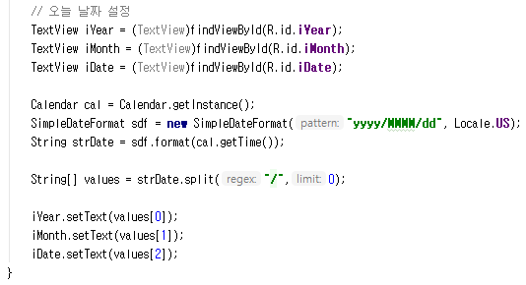
문화콘텐츠 마케팅
기말평가 영화재마케팅하기
Software Engineering
Study app ‘Jaksimsamil’
Unit 01 ㅣ 마케팅 환경분석 _ Market Environment Analysis
Unit 03 ㅣ Structures of Application
Calendar class
- Used to present information
about the date
- an abstract class
→ use getInstance() method
➔ represent Date information
SimpleDateFormat class
- Date formatting

Slide 16
문화콘텐츠 마케팅
기말평가 영화재마케팅하기
Software Engineering
Study app ‘Jaksimsamil’
Unit 01 ㅣ 마케팅 환경분석 _ Market Environment Analysis
Unit 03 ㅣ Structures of Application
Function: Board
Can see the lists of writings
Click the “Write” button
- can write: title, name, phone number,
contents
Click the “Push” button
→ writing is updated on the list
Click writing → can revise & delete writing

Slide 17
문화콘텐츠 마케팅
기말평가 영화재마케팅하기
Software Engineering
Study app ‘Jaksimsamil’
Unit 01 ㅣ 마케팅 환경분석 _ Market Environment Analysis
Unit 03 ㅣ Structures of Application
Function: Calendar
GridView: displaying the date
- ViewGroup → displays items in a two-dimensional,
scrollable grid
Enter year and month → shows corresponding
calendar

Slide 18
문화콘텐츠 마케팅
기말평가 영화재마케팅하기
Software Engineering
Study app ‘Jaksimsamil’
Unit 01 ㅣ 마케팅 환경분석 _ Market Environment Analysis
Unit 03 ㅣ Structures of Application
Function: Calendar
Enter year and month
➔ show corresponding calendar
Enter date
- can insert schedule using button
Can save title, date, time and memo

Slide 19
문화콘텐츠 마케팅
기말평가 영화재마케팅하기
Software Engineering
Study app ‘Jaksimsamil’
Unit 01 ㅣ 마케팅 환경분석 _ Market Environment Analysis
Unit 03 ㅣ Structures of Application
Asynctask object
thread → provide basic method for developer’s convenience.
Established to use background & UI thread together easily
Applicable for simple task unlike usual thread
Can not be reused
Without any direction → not closed

Slide 20
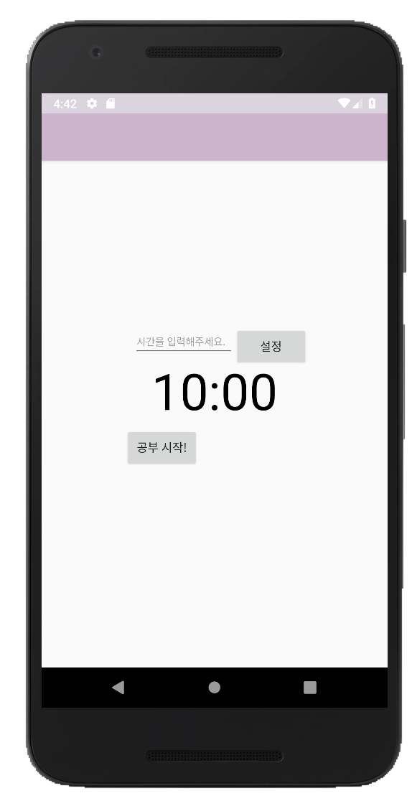
문화콘텐츠 마케팅
기말평가 영화재마케팅하기
Software Engineering
Study app ‘Jaksimsamil’
Unit 01 ㅣ 마케팅 환경분석 _ Market Environment Analysis
Unit 03 ㅣ Structures of Application
Function: Alarm
Use CountDownTimer
- using “Cancel” to "Cancel countdown - using “onFinish” to End - using “Start” to Start

Slide 21
Q &A
Thank You

